Slide 1
ACF 302: Week 7 (&8?) Working capital management and Short Term Financing
Berk and DeMarzo Chapters 26 and 27

Slide 2
Disclaimer
Don’t panic about the length of this file!
It covers two chapters, out of which one is a brief revision of concepts you have seen before and you are already familiar.
There are plenty of numerical examples. I might go through some of them during the lecture, but others are there solved so you have additional practice for home.
This material is usually covered in more than one lecture (this means you will still use it during week 8).

Slide 3
Intro: Short term vs. Long term
So far we have studied how long term financial decisions are made within a firm (e.g. projects that take place through many years).
Now we focus on short-term (within a year) financial management of a corporation.
In a perfect capital market (no frictions), the way a firm choses to manage its short-term financial needs does not affect the value of the firm.
BUT in practice short-term financial policies DO matter because THERE ARE market frictions.
Identify those frictions
How do firms set their short-term financial policies.

Slide 4
One topic, two chapters.
Chapter 26: How firms manage their working capital requirements.
Chapter 27: How firms finance their short-term cash needs.

Slide 5
Working Capital Management
Chapter 26

Slide 6
Chapter Outline
26.1 Overview of Working Capital
26.2 Trade Credit
26.3 Receivables Management
26.4 Payables Management
26.5 Inventory Management
26.6 Cash Management

Slide 7
Learning Objectives (1 of 2)
Define working capital management, cash cycle, and operating cycle.
Compute the cost of trade credit and compare that cost to alternative sources of financing.
Discuss ways that companies provide trade credit to their customers.

Slide 8
Learning Objectives (2 of 2)
List the three steps involved in establishing a credit policy, and two methods used to monitor the effectiveness of that policy.
Discuss the importance of monitoring accounts payable, inventory, and cash; identify ways those items can be managed.

Slide 9
26.1 Overview of Working Capital
Most projects require the firm to invest in net working capital.
Net Working Capital = current assets – current liabilities.
It’s the capital required in the short term to run the business.
How much to invest in each account will depend on the type of firm/industry.
Current Assets | Current Liabilities
Cash | Accounts payable
Inventory
Accounts receivable

Slide 10
26.1 Overview of Working Capital
An increase in Net Working Capital represents an investment that reduces the cash available to the firm.
Working capital alters the cash flows → Affects firm value.

Slide 11
Let’s make a quick revision of the Cash Cycle
Cash conversion cycle
Operating Cycle

Slide 12
Figure 26.1 The Cash and Operating Cycle for a Firm

Slide 13
The Cash Cycle (1 of 3)
Cash Cycle
The length of time between when a firm pays cash to purchase its initial inventory and when it receives cash from the sale of the output produced from that inventory

Slide 14
The Cash Cycle (2 of 3)
Cash Conversion Cycle (CCC)
A measure of the cash cycle

Slide 15
The Cash Cycle (3 of 3)
Operating Cycle
The average length of time between when a firm originally purchases its inventory and when it receives the cash back from selling its product
Most firms buy their inventory on credit, which reduces the amount of time between the cash investment and the receipt of cash from that investment.

Slide 16
Table 26.1 Working Capital in Various Industries (2015) (1 of 2)
Company | Ticker | Industry | Accounts Receivable Days | Inventory Days | Accounts Payable Days | CCC
Molson Coors Brewing | TAP | Brewing | 48 | 37 | 184 | −99
Pepsico | PEP | Beverages | 40 | 40 | 164 | −84
Verizon Communications | VZ | Telecommunications | 37 | 8 | 117 | −72
Apple | AAPL | Computer Hardware | 20 | 7 | 76 | −49
Bristol-Myers Squibb | BMY | Pharmaceuticals | 72 | 126 | 223 | −25
South West Airlines | LUV | Airlines | 9 | 9 | 32 | −14
Amazon.com | AMZN | Internet Retail | 19 | 45 | 73 | −9
The New York Times | NYT | Publishing | 41 | 0 | 49 | −8
Chipotle Mexican Grill | CMG | Restaurants | 2 | 2 | 10 | −6
The Kroger Co. | KR | Grocery Stores | 4 | 24 | 23 | 5

Slide 17
Table 26.1 Working Capital in Various Industries (2015) (2 of 2)
Company | Ticker | Industry | Accounts Receivable Days | Inventory Days | Accounts Payable Days | CCC
Wal-Mart Stores | WMT | Superstores | 4 | 47 | 39 | 12
Microsoft | MSFT | Software | 62 | 33 | 77 | 18
Macy’s | SHLD | Department Stores | 4 | 147 | 133 | 18
FedEx | FDX | Air Freight | 43 | 5 | 22 | 26
Star Bucks | SBUX | Restaurants | 12 | 30 | 16 | 26
Nordstrom | JWN | Department Stores | 29 | 79 | 62 | 46
Nike | NKE | Footwear | 36 | 91 | 41 | 86
Brown-Forman | BF.B | Distillers and Vintners | 72 | 440 | 90 | 422
Lennar | LEN | Homebuilding | 3 | 463 | 23 | 443
Sotheby’s | BID | Auction Services | 393 | 169 | 117 | 445
Tiffany & Co. | TIF | Luxury Goods | 17 | 546 | 66 | 497
Major U.S. Firms (value-weighted average)
Source: www.capitaiq.com

Slide 18
Firm Value and Working Capital
Any reduction in working capital requirements generates a positive free cash flow that the firm can distribute immediately to shareholders.
Thus, efficiently managing working capital will maximize firm value.

Slide 19
Textbook Example 26.1 (1 of 3)
Costly Working Capital for a Project
Problem
Emerald City Paints would like to construct a new facility that will manufacture paint. In addition to the capital expenditure on the plant, management estimates that the project will require an investment today of $450,000 for net working capital. The firm will recover the investment in net working capital eight years from today, when management anticipates closing the plant. The discount rate for this type of cash flow is 6% per year.
What is the present value of the cost of working capital for the paint facility?
What is the value of an inventory policy that would halve the plant’s net working capital requirements?

Slide 20

Textbook Example 26.1 (2 of 3)
Solution
The cash flows for the investment in net working capital are −$450,000 today and +$450,000 eight years from today. Putting this on a timeline:

Slide 21
Textbook Example 26.1 (3 of 3)
Given a discount rate of 6% per year, the NPV of these cash flows is
Although Emerald City Paints receives back all of its investment in working capital, it loses the time value of money on this cash. If a new inventory policy could halve this requirement, it would be worth
to the firm.
Notes:
Work at home the alternative example!

Slide 22
26.2 Trade Credit
Trade Credit
The credit that the firm extends to its customers.

Slide 23
Trade Credit Terms (1 of 2)
Net 30
Payment is not due until 30 days from the date of the invoice.
Note: The number of days may vary, such as Net 15 or Net 60.

Slide 24
Trade Credit Terms (2 of 2)
Net 30
If the buyer pays within 10 days, they will receive a 2% discount, otherwise the full amount is due in 30 days.
Firms offer discounts to encourage customers to pay early. However, the discount also represents a cost to the selling firm.
Note: The discount and number of days may vary, such as
Net 20 or
Net 45.

Slide 25
Trade Credit and Market Frictions (1 of 6)
Cost of Trade Credit
Assume a firm sells a product for $100 and offers its customer terms of
net 30.
The customer doesn’t have to pay anything for the first 10 days, so it effectively has a zero-interest loan for this period.
If the customer takes advantage of the discount and pays within the 10-day discount period, the customer pays only $98 for the product.

Slide 26
Always draw a timeline!
0 days
10 days
30 days
Discount period:
Customer owes $98
Net period:
Customer owes $100
Last day customer pay no penalties for late payment
Last day customer gets discount

Slide 27
Trade Credit and Market Frictions (2 of 6)
Cost of Trade Credit
Rather than pay within 10 days, the customer has the option to use the $98 for an additional 20 days
The interest rate for the 20-day term of the loan is
With a 365-day year, this rate over 20 days corresponds to an effective annual rate of:

Slide 28
Trade Credit and Market Frictions (3 of 6)
Cost of Trade Credit
By not taking the discount, the firm is effectively paying 44.6% annually to finance the purchase.
If the firm can obtain a bank loan at a lower interest rate, it would be better off borrowing at the lower rate on day 10 and using the cash proceeds of the loan to take advantage of the discount offered by the supplier. The firm would then repay the bank loan on day 30.

Slide 29
Textbook Example 26.2 (1 of 2)
Estimating the Effective Cost of Trade Credit
Problem
Your firm purchases goods from its supplier on terms of
Net 40. What is the effective annual cost to your
firm if it chooses not to take advantage of the trade discount offered?

Slide 30
Textbook Example 26.2 (2 of 2)
Solution
Because the discount is 1% for a $100 purchase your firm must pay either $99 in 15 days or $100 in 40 days. Given the difference of 25 days (40 − 15), these terms correspond to an effective annual rate of

Slide 31
Trade Credit and Market Frictions (4 of 6)
Benefits of Trade Credit
Trade credit is simple and convenient to use, and it therefore has lower transaction costs than alternative sources of funds.
It is a flexible source of funds and can be used as needed.
It is sometimes the only source of funding available to a firm.

Slide 32
Trade Credit and Market Frictions (5 of 6)
Trade Credit Versus Standard Loans
Why offer trade credit?
Providing financing at below-market rates is an indirect way to lower prices for only certain customers.
For example, automobile manufacturer’s often offer low cost financing, but only for the most qualified buyers.

Slide 33
Trade Credit and Market Frictions (6 of 6)
Trade Credit Versus Standard Loans
Why offer trade credit?
Because a supplier may have an ongoing business relationship with its customer, it may have more information about the credit quality of the customer than a bank.
If the buyer defaults, the supplier may be able to seize the inventory as collateral.

Slide 34
Managing Float (1 of 3)
Collection Float
The amount of time it takes for a firm to be able to use funds after a customer has paid for its goods
It consists of mail float, processing float, and availability float.
Mail Float
How long it takes a firm to receive a customer's payment check after the customer has mailed it.

Slide 35
Managing Float (2 of 3)
Collection Float
Processing Float
How long it takes a firm to process a customer’s payment check and deposit it in the bank
Availability Float
How long it takes a bank to give a firm credit for customer payments the firm has deposited in the bank

Slide 36
Managing Float (3 of 3)
Disbursement Float
The amount of time it takes before a firm’s payments to its suppliers actually result in a cash outflow for the firm
It is a function of mail float, processing float, and check-clearing float.

Slide 37
26.3 Receivables Management
Determining the Credit Policy
Establishing Credit Standards
Determine who will qualify for credit.
Establishing Credit Terms
Determine the “net” period and if a discount will be offered.
Establishing a Collection Policy
Determine course of action to take if a customer does not pay as agreed.

Slide 38
Monitoring Accounts Receivable (1 of 2)
Accounts Receivable Days
The accounts receivable days is the average number of days that it takes a firm to collect on its sales.
A firm can compare the accounts receivable days to the credit terms.
For example, if the credit terms specify “net 30” and the accounts receivable days outstanding is 45 days, the firm can conclude that its customers are paying 15 days late, on average.
A firm can look at the trend in accounts receivable days.

Slide 39
Monitoring Accounts Receivable (2 of 2)
Aging Schedule
Categorizes a firm’s accounts by the number of days they have been on the firm’s books
It can be prepared using either the number of accounts or the dollar amount of the accounts receivable outstanding.

Slide 40
Table 26.2 Aging Schedules
Days Outstanding | Number of Accounts | Percent of Accounts (%) | Amount Outstanding ($) | Percent Outstanding (%)
1−15 | 220 | 38.6 | 530,000 | 33.1
16−30 | 190 | 33.3 | 450,000 | 28.1
31−45 | 80 | 14.0 | 350,000 | 21.9
46−60 | 60 | 10.5 | 200,000 | 12.5
60+ | 20 | 3.5 | 70,000 | 4.4
Blank | 570 | 100.0 | 1,600,000 | 100.0

Slide 41
Monitoring Accounts Receivable
Payment Pattern
Provides information on the percentage of monthly sales that the firm collects in each month after the sale
For example, a firm may observe that 10% of its sales are usually collected in the month of the sale, 40% in the month following the sale, 25% two months after the sale, 20% three months after the sale, and 5% four months after the sale.
Management can then watch for deviations from this pattern.

Slide 42
26.4 Payables Management
A firm should borrow using accounts payable only if trade credit is the least expensive source of funding.
The cost of the trade credit depends on the credit terms.
The higher the discount percentage offered, the greater the cost of forgoing the discount.
The shorter the loan period, the greater the cost of forgoing the discount.
A firm should always pay on the latest day allowed.

Slide 43
Determining Accounts Payable Days Outstanding
A firm should monitor its accounts payable to ensure that it is making its payments at an optimal time.
Calculate the accounts payable days outstanding and compare it to the credit terms.
If the accounts payable outstanding is 45 days and the terms are
net 30, the firm can conclude that it
generally pays late and may be risking supplier difficulties.
If the accounts payable days outstanding is 20 days, the firm is paying too early. It could be earning another 10 days’ interest on its money.

Slide 44
Textbook Example 26.4 (1 of 2)
Accounts Payable Management
Problem
The Rowd Company has an average accounts payable balance of $250,000. Its average daily cost of goods sold is $14,000, and it receives terms of
net 40,
from its suppliers. Rowd chooses to forgo the discount. Is the firm managing its accounts payable well?

Slide 45
Textbook Example 26.4 (2 of 2)
Solution
The firm is not managing its accounts payable well. Rowd’s accounts payable days outstanding is
If Rowd made payment three days earlier, it could take advantage of the 2% discount. If for some reason it chooses to forgo the discount, it should not be paying the full amount until the fortieth day.

Slide 46
Stretching Accounts Payable
Stretching the Accounts Payable
When a firm ignores a payment due period and pays later
For example:
Given Net 30 terms, a firm may pay on day 45.
Given
Net 30 terms, a firm may pay on day
12 and still take the 2% discount.
Suppliers may react to a firm whose payments are always late by imposing late fees or terms of cash on delivery (COD) or cash before delivery (CBD).

Slide 47
Textbook Example 26.5 (1 of 2)
Cost of Trade Credit with Stretched Accounts Payable
Problem
What is the effective annual cost of credit terms of
net 40,
if the firm stretches the accounts payable to 60 days?

Slide 48
Textbook Example 26.5 (2 of 2)
Solution
The interest rate per period is
If the firm delays payment until
the sixtieth day, it has use of the funds for 45 days beyond the discount period. There are
45-day periods in one year. Thus, the
effective annual cost is

Slide 49
26.5 Inventory Management (1 of 2)
Benefits of Holding Inventory
Prevent stock-outs: running out of goods.
Seasonality in demand
Costs of Holding Inventory
Acquisition costs
Order costs (costs of placing the order)
Carrying costs (storage, insurance, taxes, spoilage, obsolescence, opportunity cost)
Minimizing these costs involves trade-offs.
Assuming no quantity discounts, the lower the inventory, the lower its carrying costs, but the higher its annual order costs.

Slide 50
26.5 Inventory Management (2 of 2)
Just-in-Time (JIT) Inventory Management
When a firm acquires inventory precisely when needed so that its inventory balance is always zero, or very close to it
JIT is often used to reduce carrying costs as much as possible

Slide 51
26.6 Cash Management
Motivation for Holding Cash
Transactions Balance
The amount of cash a firm needs to be able to pay its bills
Precautionary Balance
The amount of cash a firm holds to counter the uncertainty surrounding its future cash needs
Compensating Balance
An amount a firm’s bank may require the firm to maintain in an account at the bank as compensation for services the bank may perform

Slide 52
Alternative Investments
We want to manage the use of working capital to generate an excess cash that will increase the firm value. But where can we invest this extra cash?
Thus far, it has been assumed that the firm will invest any cash in short-term securities.
A firm may choose from a variety of short-term securities that differ with regard to their default risk and liquidity risk.

Slide 53
Table 26.3 Money Market Investment Options (1 of 4)
Investment | Description | Maturity | Risk | Liquidity
Treasury Bills | Short-term debit of the U.S. government | Four weeks, three months (91 days), six months (182 days) or one year when newly issued | Default risk free | Very liquid and marketable.
Certificates of deposit (CDs) | Short-term debit issued by banks, minimum denomination of $100,000. | Varying maturities up to one year | If the issuing bank is insured by FDIC, any amount to $250,000 is free of default risk because it is covered by the insurance. Any amount in excess of $250,000 is not insured and is subjected to default risk | Unlike CDs purchased by individuals, these CDs sell on the secondary market, but less liquid than treasury bills.

Slide 54
Table 26.3 Money Market Investment Options (2 of 4)
Investment | Description | Maturity | Risk | Liquidity
Repurchase agreement | Essentially a loan arrangement wherein a securities dealer is the “borrower” and the investor is the “lender”, the investor buys securities such as U.S. treasury bills, from the securities dealer, with an arrangement to sell the securities back to the dealer at a later date for a specified higher price. | Very short-term, ranging from overnight to approximately three months in duration | The security severs as collateral for the loan, and therefore the investor is exposed to very little risk. However, the investor needs to consider the creditworthiness of the security dealer when assessing the risk. | No secondary market for repurchase agreement.

Slide 55
Table 26.3 Money Market Investment Options (3 of 4)
Investment | Description | Maturity | Risk | Liquidity
Bankers Acceptances | Drafts written by the borrower and guaranteed by the bank on which the draft is drawn, typically used in international trade transaction; the borrower is the importer who writes the draft in payment of goods. | Typically one to six months | Because both the borrower and the bank have guaranteed the draft, there is usually very little risk. | When the exporter receives the draft, he may hold it until maturity and receives its full value or he sell the draft at a discount prior to maturity.
Commercial Paper | Short-term unsecured debts issued by large corporations. The denomination is $25,000, but most commercial paper has a face value of $100,000 or more. | Typically one to six months | Default risk depends on creditworthiness of the issuing corporation | No active secondary market, but issuer may repurchase commercial paper.

Slide 56
Table 26.3 Money Market Investment Options (4 of 4)
Investment | Description | Maturity | Risk | Liquidity
Short-Term Tax Exempts | Short-term debt for the state and local government; these instruments pay interest that is exempts from federal taxation, so their pre-tax yield is lower than that of a similar-risk, fully taxable investment. | Typically one to six months | Default risk depends on creditworthiness of the issuing corporation | Moderate secondary market.

Slide 57
End of Working Capital management!
…Stay tuned for Short term financing part I

Slide 58
Short- Term Financial Planning (part I)
Berk & DeMarzo Chapter 27

Slide 59
Chapter Outline
27.1 Forecasting Short-Term Financing Needs
27.2 The Matching Principle
27.3 Short-Term with Bank Loans
27.4 Short-Term with Commercial Paper
27.5 Short-Term Financing with Secured Financing

Slide 60
Learning Objectives (1 of 2)
Show how future cash flow forecasts allow a company to determine whether it has a cash flow surplus or deficit, and whether it is a long- or short-term imbalance.
Discuss the recommendations of the matching principle with respect to long- and short-term needs for funds.
Describe three types of bank loans, and how they may be used for short-term cash needs.

Slide 61
Learning Objectives (2 of 2)
Identify the factors that affect the effective annual rate of a bank loan.
Define commercial paper, and discuss its advantages for large corporations.
Describe the use of inventory and accounts receivable as security for loans.
Define factoring, floating liens, trust receipts loan, and a warehouse arrangement.

Slide 62
27.1 Forecasting Short-Term Financing Needs (1 of 5)
The focus of this lecture is on short-term financial planning.
The focal point is analyzing the types of cash surpluses or deficits that are temporary and short-term in nature.

Slide 63
27.1 Forecasting Short-Term Financing Needs (2 of 5)
Assume that it is December 2018. Springfield Snowboards manufactures snowboarding equipment, which it sells primarily to retailers.
Springfield anticipates that in 2019 its sales will grow by 10% to $20 million and its total net income will be $1,950,000.
Assuming sales and production will occur uniformly throughout the year, management’s forecast of its quarterly net income and statement of cash flows for 2019 is presented on the following slide.

Slide 64
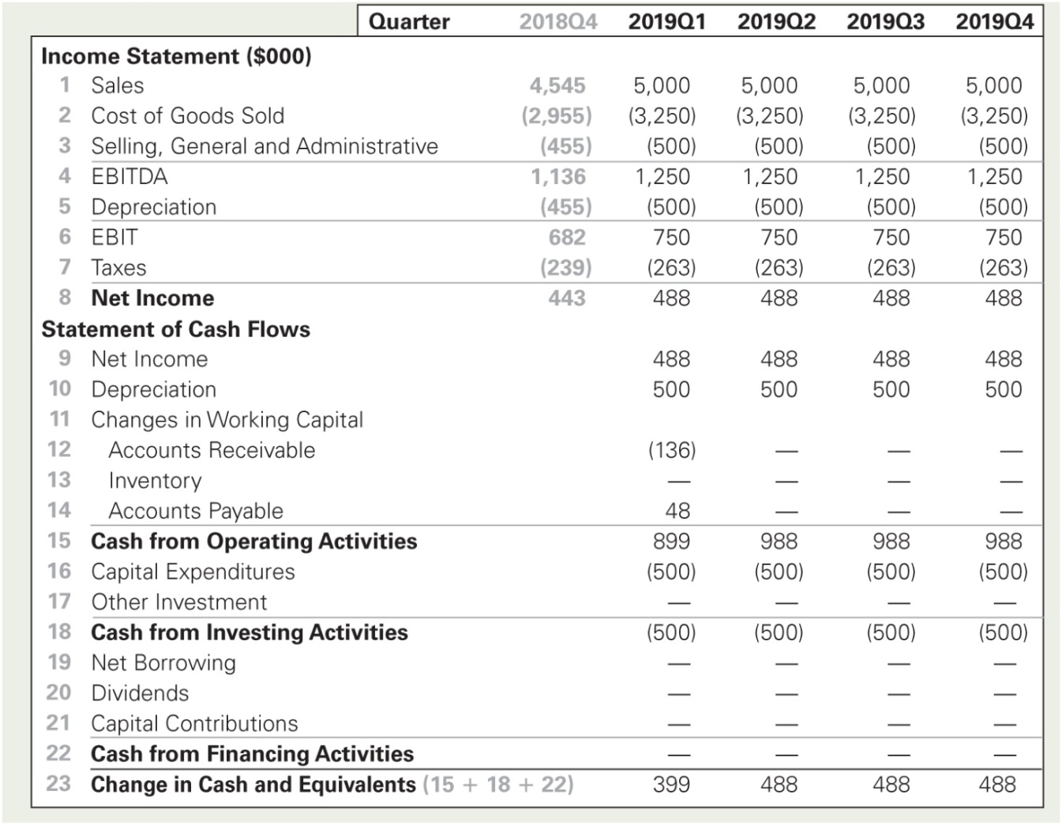
Table 27.1 Spreadsheet Projected Financial Statements for Springfield Snowboards, 2019, Assuming Level Sales

Slide 65
27.1 Forecasting Short-Term Financing Needs (3 of 5)
Springfield’s quarterly net income is $488,000.
Its capital expenditures are equal to depreciation.
Its working capital requirements increase in the first quarter due to the increase in sales but remain constant thereafter.

Slide 66
27.1 Forecasting Short-Term Financing Needs (4 of 5)
Based on these projections, Springfield will accumulate excess cash on an ongoing basis.
If the surplus is likely to be long term, Springfield could reduce the surplus by paying some of it out as a dividend or by repurchasing shares.

Slide 67
27.1 Forecasting Short-Term Financing Needs (5 of 5)
Firms require short-term financing for
Seasonalities
Negative cash flow shocks
Positive cash flow shocks

Slide 68
Seasonalities (1 of 3)
For many firms, sales are seasonal.
When sales are concentrated during a few months, sources and uses of cash are also likely to be seasonal.

Slide 69
Figure 27.1 Sales Seasonality (2010–2015)

Slide 70
Seasonalities (2 of 3)
In the Springfield example, it was previously assumed that sales occur uniformly throughout the year.
Now assume that 20% of sales occur during the first quarter, 10% during each of the second and third quarters, and 60% of sales during the fourth quarter.
The new forecasted statement of cash flows is shown on the following slide.
Note: It is still assumed that production occurs uniformly throughout the year.

Slide 71
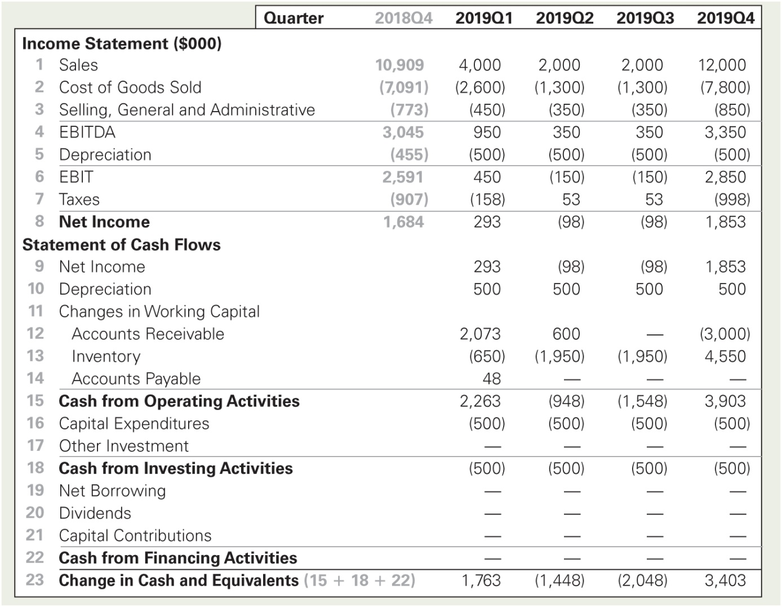
Table 27.2 Spreadsheet Projected Financial Statements for Springfield Snowboards, 2019, Assuming Seasonal Sales

Slide 72
Seasonalities (3 of 3)
Although net income is unchanged from the original forecast, the introduction of seasonal sales creates some dramatic swings in Springfield’s short-term cash flows.
As a result, Springfield has negative net cash flows during the second and third quarters.

Slide 73
Negative Cash Flow Shocks (1 of 3)
Occasionally, a company will encounter circumstances in which cash flows are temporarily negative for an unexpected reason, creating a short-term financing need.

Slide 74
Negative Cash Flow Shocks (2 of 3)
In the Springfield example, assume that during April 2019, management learns that some manufacturing equipment has broken unexpectedly.
It will cost an additional $1,000,000 to replace the equipment.
The impact is shown on the following slide.
Note: The original assumption of level sales is used.

Slide 75
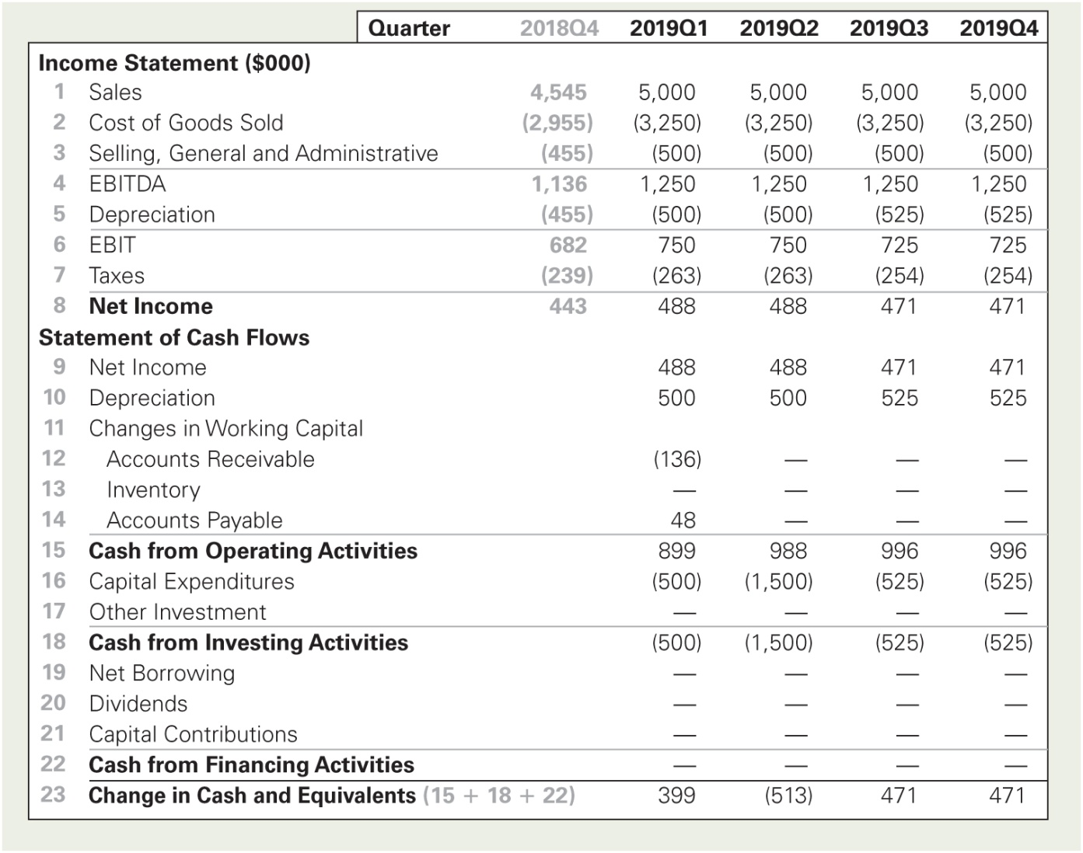
Table 27.3 Spreadsheet Projected Financial Statements for Springfield Snowboards, 2019, Assuming Level Sales and a Negative Cash Flow Shock

Slide 76
Negative Cash Flow Shocks (3 of 3)
In this case, the one-time expenditure of $1 million to replace equipment results in a negative net cash flow of $513,000 during the second quarter of 2019.
If its cash reserves are insufficient, Springfield will have to borrow to cover the $513,000 shortfall.
However, the company continues to generate positive cash flow in the following quarters, and by the fourth quarter it will have generated enough cumulative cash flow to repay any loan.

Slide 77
Positive Cash Flow Shocks (1 of 5)
Now assume that during the first quarter of 2019, Springfield announces a deal where it will be the exclusive supplier to a new major customer, leading to an overall sales increase of 20% for the firm.

Slide 78
Positive Cash Flow Shocks (2 of 5)
The increased sales will begin in the second quarter.
As part of the deal, Springfield has agreed to a one-time expense of $500,000 for marketing.
An extra $1 million in capital expenditures is also required during the first quarter to increase production capacity.

Slide 79
Positive Cash Flow Shocks (3 of 5)
The sales growth will also affect Springfield’s required working capital.
The new cash flow forecasts are shown on the following slide.

Slide 80
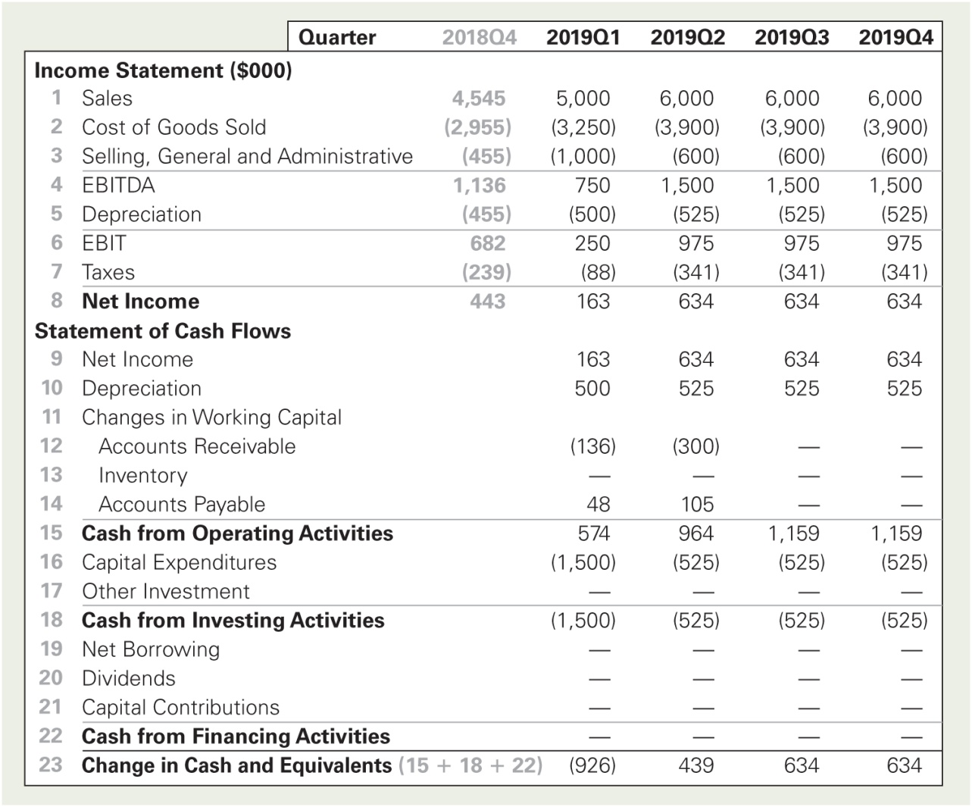
Table 27.4 Spreadsheet Projected Financial Statements for Springfield Snowboards, 2019, Assuming Level Sales and a Growth Opportunity

Slide 81
Positive Cash Flow Shocks (4 of 5)
Forecasted net income is lower during the first quarter, due to the $500,000 increase in marketing expenses.
However, net income in the following quarters is higher, reflecting the higher sales.
There is an increase in accounts receivable and accounts payable during the first two quarters due to the higher level of sales.

Slide 82
Positive Cash Flow Shocks (5 of 5)
Even though the opportunity to grow more rapidly is positive, it results in a negative net cash flow during the first quarter.
However, because the company will be even more profitable in subsequent quarters, this financing need is temporary.

Slide 83
27.2 The Matching Principle
Matching Principle
States that a firm’s short-term needs should be financed with short-term debt and long-term needs should be financed with long-term sources of funds

Slide 84
Permanent Working Capital
Permanent Working Capital
The amount that a firm must keep invested in its short-term assets to support its continuing operations
The matching principle suggests that the firm should finance this permanent investment in working capital with long-term sources of funds.

Slide 85
Temporary Working Capital (1 of 4)
Temporary Working Capital
The difference between the actual level of short-term working capital needs and its permanent working capital requirements
The matching principle suggests that the firm should finance this temporary investment in working capital with short-term sources of funds.

Slide 86
Temporary Working Capital (2 of 4)
The Springfield example with seasonal sales illustrates the difference between permanent and temporary working capital.
The following slide shows the levels of working capital that correspond to the seasonal forecasts.

Slide 87
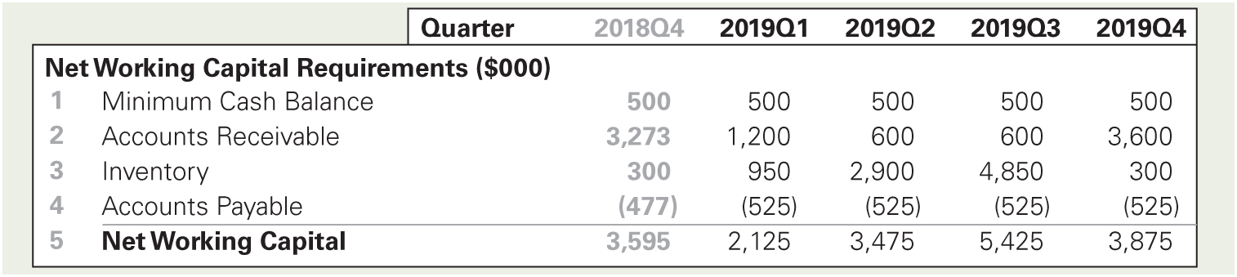
Table 27.5 Spreadsheet Projected Levels of Working Capital for Springfield Snowboards, 2019, Assuming Seasonal Sales

Slide 88
Temporary Working Capital (3 of 4)
Springfield’s working capital varies from a minimum of $2,125,000 in the first quarter of 2019 to $5,425,000 in the third quarter.
The minimum level of working capital, $2,125,000, can be thought of as the firm’s permanent working capital.

Slide 89
Temporary Working Capital (4 of 4)
The difference between this minimum level and the higher levels in subsequent quarters reflects Springfield’s temporary working capital requirements.
For example, in 2019Q3, the temporary working requirements are $3,300,000.
$5,425,000 – $2,125,000 = $3,300,000

Slide 90
Financing Policy Choices (1 of 2)
Aggressive Financing Policy
Financing part or all of a firm’s permanent working capital with short-term debt
One risk of an aggressive financing policy is funding risk.
Funding Risk
The risk of incurring financial distress costs should a firm not be able to refinance its debt in timely manner or at a reasonable rate

Slide 91
Financing Policy Choices (2 of 2)
Conservative Financing Policy
Financing all of a firm’s permanent working capital with long-term debt

Slide 92
End of Short Term Financing part I
…Stay tuned for Short term financing part II

Slide 93
Short Term Financing part II
Financial instruments

Slide 94
Roadmap: Financial instruments that can be used to cover the short term financial needs.
Bank Loans
Single End-of-period loan
Line of credit
Uncommitted
Committed
Revolving
Evergreen
Bridge Loan
Commercial Paper
Direct Paper
Commercial Paper
Secured Financing
Secured Loans
Assets
Accounts receivables
Inventory
Floating Lien
Trust receipt
Warehouse arrangement
Public Warehouse
Field Warehouse
Factor
Accounts receivable
With recourse
Without recourse

Slide 95
27.3 Short-Term Financing with Bank Loans
Promissory Note
A written statement that indicates:
the amount of a loan,
the date payment is due,
the interest rate.

Slide 96
Single, End-of-Period Payment Loan (1 of 2)
The simplest type of bank loan is a single, end-of-period-payment loan.
This type of loan requires that the firm pay interest on the loan and pay back the principal in one lump sum at the end of the loan.
The interest rate may be fixed or variable.
With a variable interest rate, the terms of the loan may indicate that the rate will vary with some spread relative to a benchmark rate.

Slide 97
Single, End-of-Period Payment Loan (2 of 2)
Prime Rate
The rate banks charge their most creditworthy customers
London Inter-Bank Offered Rate (LIBOR)
The rate of interest at which banks borrow funds from each other in the London inter-bank market.
It is quoted for maturities of one day to one year for 10 major currencies.

Slide 98
Line of Credit (1 of 4)
Line of Credit
A bank loan arrangement in which a bank agrees to lend a firm any amount up to a stated maximum
This flexible agreement allows the firm to draw upon the line of credit whenever it chooses.

Slide 99
Line of Credit (2 of 4)
Uncommitted Line of Credit
A line of credit that does not legally bind a bank to provide the funds a borrower requests.
Committed Line of Credit
A legally binding agreement that obligates a bank to provide funds to a firm (up to a stated credit limit) as long as the firm satisfies any restrictions in the agreement.

Slide 100
Line of Credit (4 of 4)
Committed Line of Credit
A committed line of credit may have
A compensating balance requirement and/or restrictions regarding the level of the firm’s working capital
A commitment fee of 0.25% to 0.50% of the unused portion of the line of credit in addition to interest on the amount that the firm borrowed
A stipulation that at some point in time the outstanding balance must be zero
This policy ensures that the firm does not use the short-term financing to finance its long-term obligations.

Slide 101
Line of Credit (5 of 4)
Revolving Line of Credit
A credit commitment for a specific time period, typically two to three years, which a company can use as needed
Evergreen Credit
A revolving line of credit with no fixed maturity

Slide 102
Bridge Loan
Bridge Loan
A type of short-term bank loan that is often used to “bridge the gap” until a firm can arrange for long-term financing
Discount Loan
A type of bridge loan in which the borrower is required to pay the interest at the beginning of the period
The lender deducts the interest from the loan proceeds when the loan is made.

Slide 103
Common Loan Stipulations and Fees (1 of 3)
Commitment Fees
The commitment fee associated with a committed line of credit, which increases the effective cost of the loan to the firm

Slide 104
Common Loan Stipulations and Fees (2 of 3)
Commitment Fees
Assume that a firm has negotiated a committed line of credit with a stated maximum of $1 million and an interest rate of 10% (EAR) with a bank.
The commitment fee is 0.5% (EAR).

Slide 105
Common Loan Stipulations and Fees (3 of 3)
Commitment Fees
At the beginning of the year, the firm borrows $800,000.
It then repays this loan at the end of the year, leaving $200,000 unused for the rest of the year. The total cost of the loan is

Slide 106
Loan Origination Fee (1 of 4)
Loan Origination Fee
A bank charge that a borrower must pay to initiate a loan
A loan origination fee reduces the amount of usable proceeds that the firm receives and increases the effective cost of the loan.

Slide 107
Loan Origination Fee (2 of 4)
Loan Origination Fee
Assume that Timmons is offered a $500,000 loan for three months at an APR of 12%.
This loan has a loan origination fee of 1%.
The loan origination fee is charged on the principal of the loan, so in this case the fee amounts to $5000, and the actual amount borrowed is $495,000.
0.01 × $500,000 = $5000

Slide 108
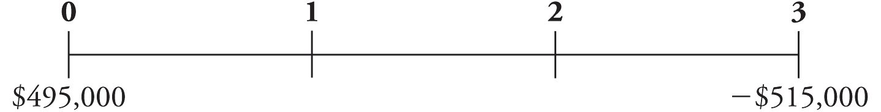
Loan Origination Fee (3 of 4)
Loan Origination Fee
The interest payment for three months is $15,000.
The time line would look like this:

Slide 109
Loan Origination Fee (4 of 4)
Loan Origination Fee
The actual three-month interest paid is 4.04%.
The effective annual rate is 17.17%.

Slide 110
Compensating Balance Requirements (1 of 4)
Assume now, rather than charging a loan origination fee, Timmons’ bank requires that the firm keep an amount equal to 10% of the loan principal in a non-interest-bearing account with the bank as long as the loan remains outstanding.

Slide 111
Compensating Balance Requirements (2 of 4)
Given a $500,000 loan, Timmons must hold $50,000 in an account at the bank.
0.10 × 500,000 = $50,000
Thus the firm has only $450,000 of the loan proceeds actually available for use, although it must pay interest on the full loan amount.

Slide 112
Compensating Balance Requirements (3 of 4)
At the end of the loan period, the firm owes $515,000.
And so must pay $465,000 after using its compensating balance.
$515,000 − $50,000 = $465,000

Slide 113
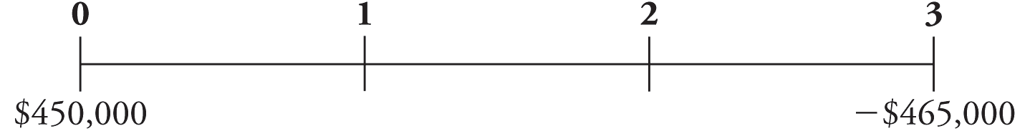
Compensating Balance Requirements (4 of 4)
The timeline would look like this:
The actual three-month interest paid is 3.33%.
The effective annual rate is 14.01%.

Slide 114
Textbook Example 27.1 (1 of 3)
Compensating Balance Requirements and the Effective Annual Rate
Problem
Assume that Timmons Towel and Diaper Service’s bank pays 1% (APR with quarterly compounding) on its compensating balance accounts. What is the EAR of Timmons’ three- month loan?

Slide 115

Textbook Example 27.1 (2 of 3)
Solution
The balance held in the compensating balance account will grow to
Thus, the final loan payment will be
500,000 + 15,000− 50,125 = $464,875. Notice that the interest on the compensating balance accounts offsets some of the interest that Timmons pays on the loan. Putting the new cash flows on a timeline:

Slide 116
Textbook Example 27.1 (3 of 3)
The actual three-month interest rate paid is
Expressing this as an EAR gives

Slide 117
27.4 Short-Term Financing with Commercial Paper (1 of 2)
Commercial Paper
Short-term, unsecured debt issued by large corporations that is usually a cheaper source of funds than a short-term bank loan
Most commercial paper has a face value of at least $100,000.
Average maturity is 30 days, and the maximum maturity is 270 days.
Commercial paper is rated by credit rating agencies.

Slide 118
27.4 Short-Term Financing with Commercial Paper (2 of 2)
Direct Paper
Commercial paper that a firm sells directly to investors
Dealer Paper
Commercial paper that dealers sell to investors in exchange for a spread (or fee) for their services
The spread decreases the proceeds that the issuing firm receives, thus increasing the effective cost of the paper.

Slide 119
Textbook Example 27.2 (1 of 2)
The Effective Annual Rate of Commercial Paper
Problem
A firm issues three-month commercial paper with a $100,000 face value and receives $98,000. What effective annual rate is the firm paying for its funds?

Slide 120

Textbook Example 27.2 (2 of 2)
Solution
Let’s put the firm’s cash flows on a timeline:
The actual three-month interest rate paid is
Expressing this as an EAR gives

Slide 121
27.5 Short-Term Financing with Secured Financing
Secured Loans
A type of corporate loan in which specific assets are pledged as a firm’s collateral
Factors
Firms that purchase the receivables of other companies and are the most common sources for secured short-term loans
Commercial banks, finance companies, and factors are the most common sources for secured short-term loans.

Slide 122
Accounts Receivable as Collateral (1 of 5)
Pledging of Accounts Receivable
An agreement in which a lender accepts accounts receivable as collateral for a loan
The lender typically lends a percentage of the value of the accepted invoices.

Slide 123
Accounts Receivable as Collateral (2 of 5)
Factoring of Accounts Receivable
An arrangement in which a firm sells receivables to the lender (the factor) and the lender agrees to pay the firm the amount due from its customers at the end of the firm’s payment period.

Slide 124
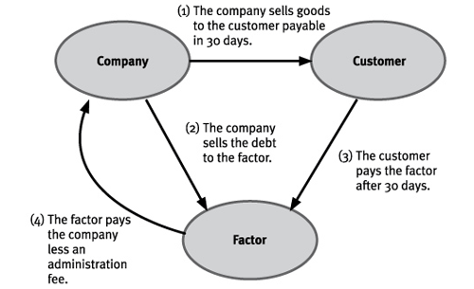
Factoring Accounts Receivable

Slide 125
Accounts Receivable as Collateral (3 of 5)
Factoring of Accounts Receivable
For example, if a firm sells its goods on net 30 terms, then the factor will pay the firm the face value of its receivables, less a factor’s fee, at the end of 30 days.
The firm may be able to borrow as much as 80% of the face value of its receivables, thereby receiving its funds in advance.
In such a case, the lender will charge interest on the loan in addition to the factor’s fee.
The lender charges the factor’s fee, which may range from 0.75% to 1.50% of the face value of the accounts receivable, whether or not the firm borrows any of the available funds.

Slide 126
Accounts Receivable as Collateral (4 of 5)
Factoring of Accounts Receivable
With Recourse
A loan in which the lender can claim all the borrower’s assets in the event of a default, not just explicitly pledged collateral
In other words, the lender can seek payment from the borrower should the borrower’s customers default on their bills.

Slide 127
Accounts Receivable as Collateral (5 of 5)
Factoring of Accounts Receivable
Without Recourse
A loan in which the lender’s claim on the borrower’s assets in the event of default is limited to only explicitly pledged collateral
In other words, the lender bears the risk of bad-debt losses.

Slide 128
Inventory as Collateral (1 of 6)
Floating Lien
A financial arrangement in which all of a firm’s inventory is used to secure a loan
Also known as General Lien or Blanket Lien
This is the riskiest setup from the standpoint of the lender because the value of the collateral used to secure the loan dwindles as inventory is sold.

Slide 129
Inventory as Collateral (2 of 6)
Trust Receipt Loan
A type of loan in which distinguishable inventory items are held in a trust as security for the loan
As these items are sold, the firm remits the proceeds from their sale to the lender in repayment of the loan.
Also known as Floor Planning

Slide 130
Inventory as Collateral (3 of 6)
Warehouse Arrangement
When the inventory that serves as collateral for a loan is stored in a warehouse
A warehouse arrangement is the least risky collateral arrangement from the standpoint of the lender; however, warehouse arrangements are expensive.
The business operating the warehouse charges a fee on top of the interest that the borrower must pay the lender for the loan.

Slide 131
Inventory as Collateral (4 of 6)
Public Warehouse
A business that exists for the sole purpose of storing and tracking the inflow and outflow of inventory
If a lender extends a loan to a borrowing firm, based on the value of the inventory, this arrangement provides the lender with the tightest control over the inventory.

Slide 132
Inventory as Collateral (5 of 6)
Field Warehouse
A warehouse arrangement that is operated by a third party but is set up on the borrower’s premises in a separate area
Inventory held in the field warehouse can be used as secure collateral for borrowing.

Slide 133
Textbook Example 27.3 (1 of 3)
Calculating the Effective Annual Cost of Warehouse Financing
Problem
The Row Cannery wants to borrow $2 million for one month. Using its inventory as collateral, it can obtain a 12% (APR) loan. The lender requires that a warehouse arrangement be used. The warehouse fee is $10,000, payable at the end of the month. Calculate the effective annual rate of this loan for Row Cannery.

Slide 134

Textbook Example 27.3 (2 of 3)
Solution
The monthly interest rate is
At the end of the month,
Row will owe $2,000,000 × 1.01 = $2,020,000 plus the warehouse fee of $10,000. Putting the cash flows on a timeline gives:

Slide 135
Textbook Example 27.3 (3 of 3)
The actual one-month interest rate paid is
Expressing this as an EAR gives

Slide 136
Inventory as Collateral (6 of 6)
The method that a firm adopts when using its inventory to collateralize a loan will affect the ultimate cost of the loan.

